Slide 1
Deployment Strategies at ALCF for Data Services
ALCF
Aditya Tanikanti

Slide 2




ALCF Current Infrastructure
Compute Nodes (Polaris 560 nodes)
Job Submission script¹
SSH using ALCF credentials
Slingshot 10/11 network
Login Nodes
Users
Metadata, Vector data, raster data etc
Storage nodes ( Shared File System Lustre)
Once the login node. Users use the job submission script. With the PBS pro scheduler to reserve nodes for the length of time specified and releases the nodes by stopping the services, once job completes. An example: qsub -A my_allocation -l place=scatter -l filesystems=home:eagle -l select=32:ncpus=32 -q prod -l walltime=30:00 script.sh. You wait in the queue if other jobs are waiting for submission. https://docs.alcf.anl.gov/polaris/queueing-and-running-jobs/job-and-queue-scheduling/

Slide 3
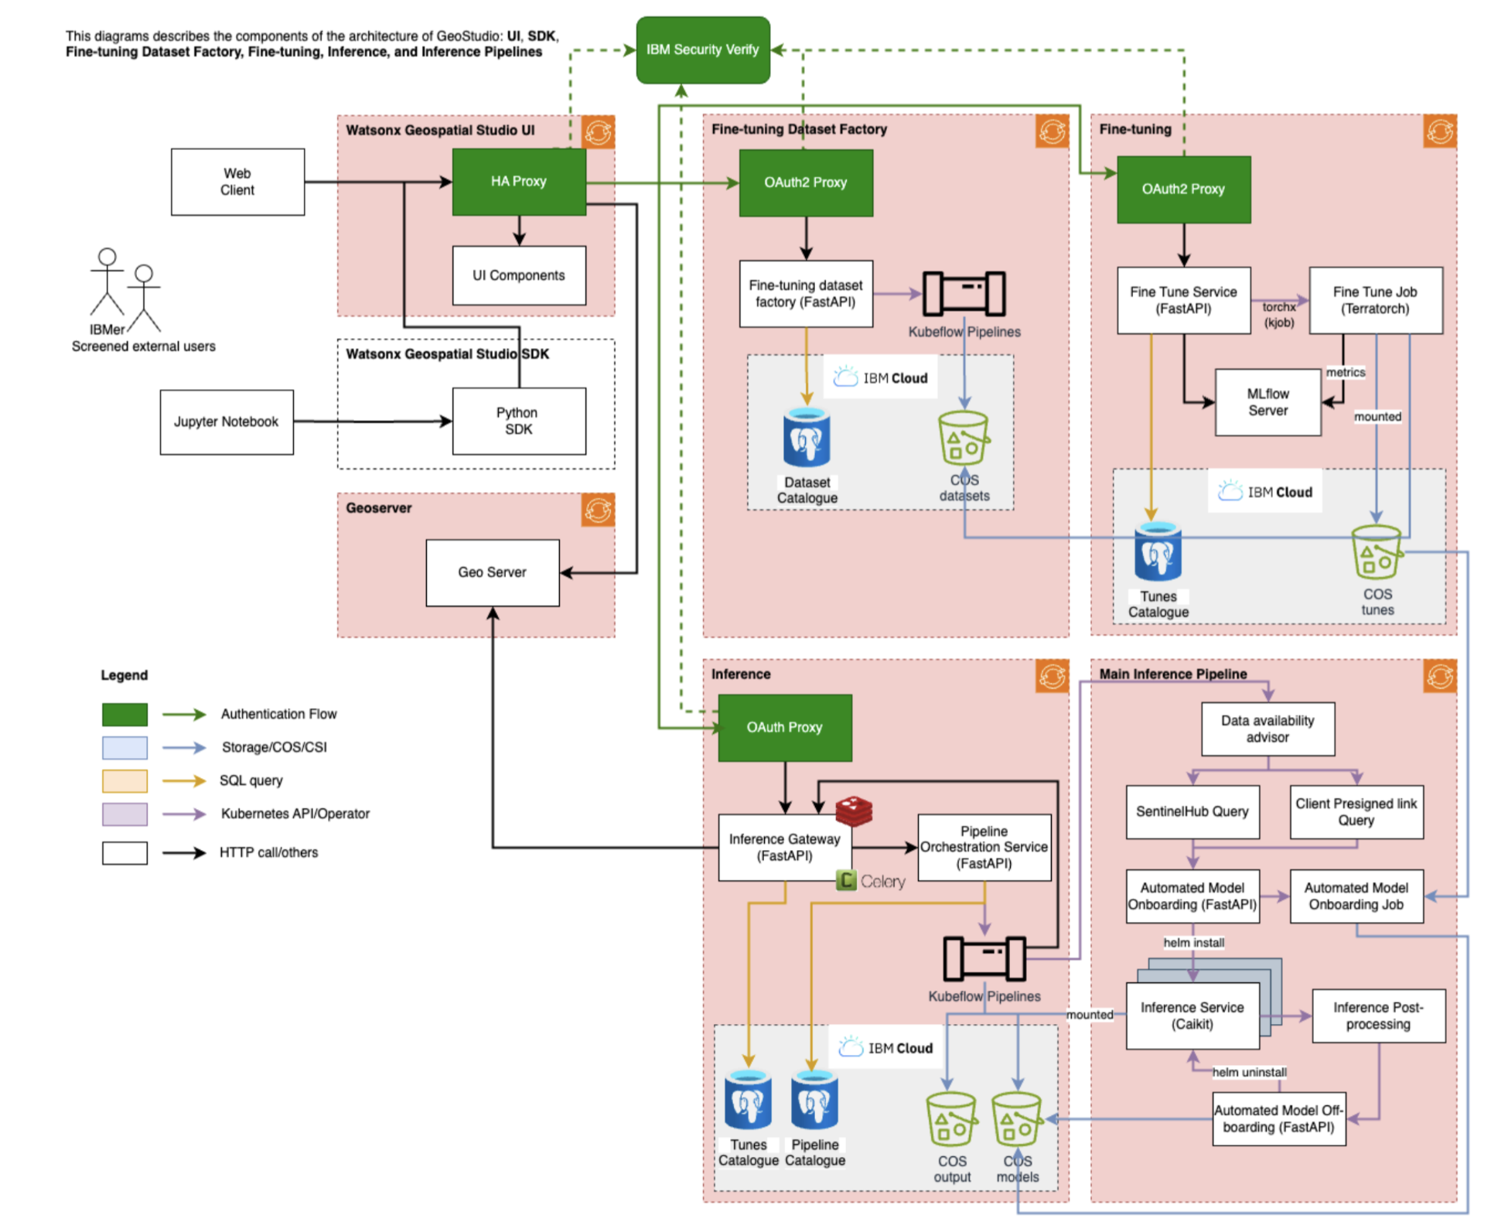
IBM Architecture

Slide 4
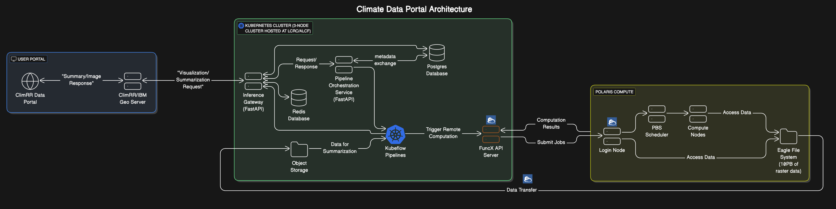
Propose Architecture

Slide 5
ARCHIVE-2022/2023

Slide 6


Proposed Infrastructure Using Globus/funcX for the Portal – Outside ALCF Network
User uses climate data portal (UI) to interact with canned data with/without ALCF credentials
API/UI server captures user requests and submits the request to Polaris compute node using FuncX (Function as a service) which interacts with the scheduler
FuncX has the required the authorization/authentication credentials to talk ALCF system
ALCF
Compute nodes (Polaris)
Cloud/CELS
Hadoop/Hbase Master
Hadoop/Hbase Data Node
Rabbit MQ
Core API
www.climatedata.alcf.anl.gov
Translates to funcX agent www.endpoint.alcf.anl.gov
FuncX submits Job Submission Script²
GeoServer
UI + Backend
Metadata Search
Data Ingestion
Meta/ Vector DB
Upload API
FUNCX
Users
Login Node
Upload API¹
Slingshot 11 network
Upload API needs authentication/authorization
The Job submission script passes request to the computes using a dedicated queue allowing for on demand computing and releases the nodes once the request is complete
Metadata, Vector data, raster data etc
Storage nodes (Lustre)

Slide 7

Requirement (IBM)
Raster store​ | 50 TB of rapidly accessible raster data, triplicated​
Users​ | Up to 200 registered users​
APIs^{a)}​ | Up to 5 requests / sec.​
Uploads​ | 500 GB / day​
Concurrent raster queries^{b)}​ | Up to​ 32 small queries​ 8 medium queries​ 4 large queries​
User network
Users
Proxy server
Hadoop/hBase
Master
Hadoop/hBase
Data node
Hadoop/hBase
Data node
GPFS
System admin
System admin.
Meta-/vector DB
Data ingestion
Core APIs
User interface
Admin network
Private network
References: IBM Research / © 2022 IBM Corporation

Slide 8


Requirement (IBM)
The wider architecture
Users
User facing services
Internal services
Data
Core API
(queries, …)
Vector service
Metadata
(Postgres)
Elastic
RabbitMQ
Vector data
(Postgres)
UI
UI backend
Redis
Users
Proxy
(NGINX)
Metadata search
Data service*
(WMS/WCS, timestamps, …)
Geoserver*
hBase
Hadoop
Upload API
Uploader
(Raster data)
IBM Research / © 2022 IBM Corporation
*Geoserver is user facing for WMS/WCS requests.

Slide 9
Current Infrastructure – Compute Nodes
Polaris is a 560 node (44 Petaflop Peak performance) HPE Apollo 6500 Gen 10+ based system.
Each node has a single 2.8 Ghz AMD EPYC Milan 7543P 32 core CPU with 512 GB of DDR4 RAM and four Nvidia A100 GPUs connected via NVLink, There are two nodes per chassis, seven chassis per rack, and 40 racks for a total of 560 nodes. https://docs.alcf.anl.gov/polaris/hardware-overview/machine-overview/
POLARIS COMPUTE | DESCRIPTION | PER NODE | AGGREGATE
Processor (Note 1) | 2.8 GHz 7543P | 1 | 560
Cores/Threads | AMD Zen 3 | 32/64 | 17,920/35,840
RAM (Note 2) | DDR4 | 512 GiB | 280 TiB
GPUS | Nvidia A100 | 4 | 2240
Local SSD | 1.6 TB | 2/3.2 TB | 1120/1.8PB

Slide 10
Proposed Infrastructure 1 – Within ALCF Network
Users from the login node, run a job submission script, which has the ansible script to bring up the services. Subsequently, user use RESTAPI (Curl)/Python API to run queries and interact with processed data
ALCF
Compute nodes (Polaris)
Hadoop/Hbase Master
Hadoop/Hbase Data Node
Rabbit MQ
Core API
Job Submission Script¹
Metadata Search
Data Ingestion
Meta/ Vector DB
Geoserver
Upload API
Slingshot 11 network
The Job submission script brings up the nodes with the required services. Processes the query and stores results in a shared file system. The system remains up with the services running as long as the wall time has not ended
Users use RESTAPI/Python API to interact with processed data
Users can also view results of the processed data by running UI+backend locally and port forwarding to display visualizations in the local browser
Login Node
Metadata, Vector data, raster data etc
Storage nodes (Lustre)

Slide 11
Proposed Infrastructure 2 – Within ALCF Network
User uses climate data portal to interact with the data with ALCF credentials.
API/UI server captures user requests and submits the request to Polaris compute node through FuncX. FuncX is the agent to interact with the compute nodes. It takes in requests, launches the services with ansible, processes the query and returns the processed data back to the UI/Geoserver within ALCF network
ALCF
Compute nodes (Polaris)
Hadoop/Hbase Master
Hadoop/Hbase Data Node
Rabbit MQ
Core API
www.climatedata.alcf.anl.gov with ALCF credentials
Geoserver
Translate requests into a job Submission Script¹
FUNCX
Metadata Search
Data Ingestion
Meta/ Vector DB
Upload API
Users
Slingshot 11 network
The Job submission script brings up the nodes with the required services. Processes the query and stores results in a shared file system. The system remains up as long as the wall time has not ended
Users use RESTAPI/Python API to interact with processed data
Users can also view results of the processed data with UI+backend
UI + Backend
Login Node
Metadata, Vector data, raster data etc
Storage nodes (Lustre)

Slide 12
Questions
Questions (IBM)
Do the UI portals have integrations with OpenID and/or Oauth2.0 for authentication/authorization
Can the portal be read only i.e. no uploads and no processing – just visualize canned data
Can users API requests be wrapped with FuncX (to be discovered). Does it need code change?
In case we do not go with centralized portal - Can we have individual users running portals locally by connecting to the backend (Geoserver)
Can all services run without sudo? Can ansible run without sudo
Time to bring up the services (Latency issues?)
How does Hadoop/Hbase run with Lustre (Shared file system) - Any issues
Questions (Internal)
Do we want only users with ALCF credentials to access the portal? Do we want a centralized service?
Latency issues, bring up time of all services and eventual time to response through dedicated queues?
Can we cleanly stop services when bringing down nodes (avoid data corruption)
Do we have artefact vulnerability scanning

